Slide 1

Analysis of Airbnb Data
A Review

Slide 2
Business Objective
The primary objective is to analyze Airbnb data to reveal insights into user experiences and satisfaction levels with the numerous listed stays, all accomplished using Power BI.

Slide 3
Project Goals:
Assessing District Location Scores : The aim is to pinpoint the location in the district with the least favorable location scores.
Examining Host Response Time Impact : The goal is to delve into the relationship between host response times and the overall ratings of Airbnb listings providing valuable insights.
Visualizing Airbnb Listing Prices : The objective is to create visual representations of Airbnb listing prices across different cities and summarize any noteworthy trends or variations.
Analyzing Composite Scores : The task involves creating a composite score that integrates check-in experience and host communication for various districts with subsequent analysis and insights.
Calculating Listing Age and Host Tenure : This objective entails computing the age of Airbnb listings and identifying hosts who have accumulated more than ten years of hosting expertise.
Property Type Price Analysis : The task involves the creation of a visual tree map that displays average prices for various room and property types with specific attention given to the property type associated with the highest prices for entire places.
Crafting a Comprehensive City Insights Report : This objective entails the creation of a comprehensive report that presents listing prices, guest ratings, and visitor trends for multiple cities, with a particular focus on assessing changes in visitor trends in 2020 in contrast to earlier years.

Slide 4
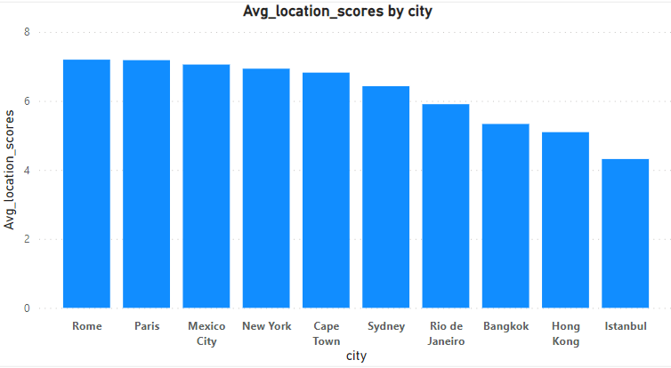
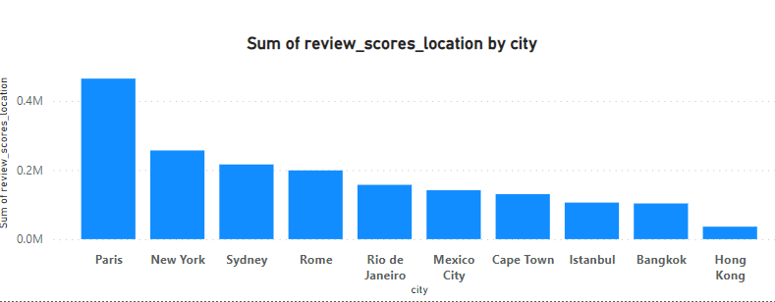
District Location Scores

Slide 5
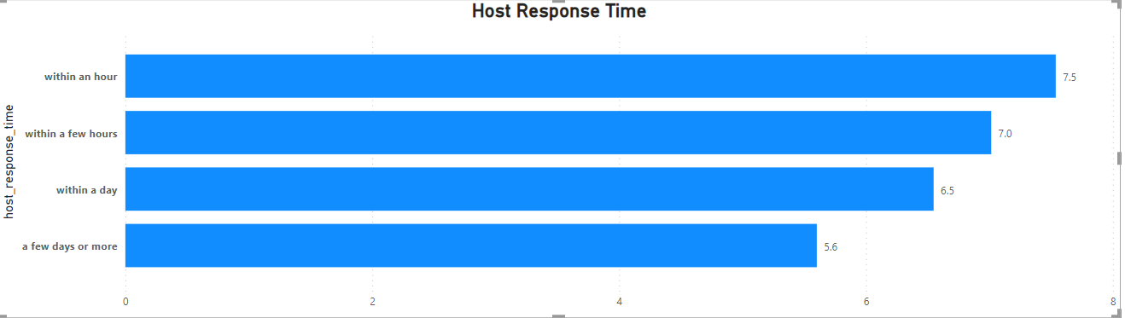
Host Response Time Impact

Slide 6
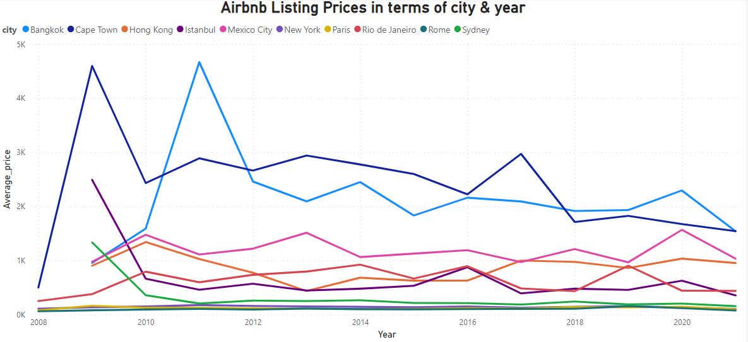
Airbnb Listing Prices

Slide 7
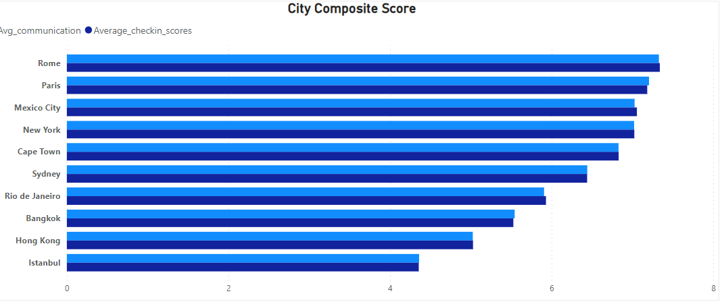
Composite Scores

Slide 8
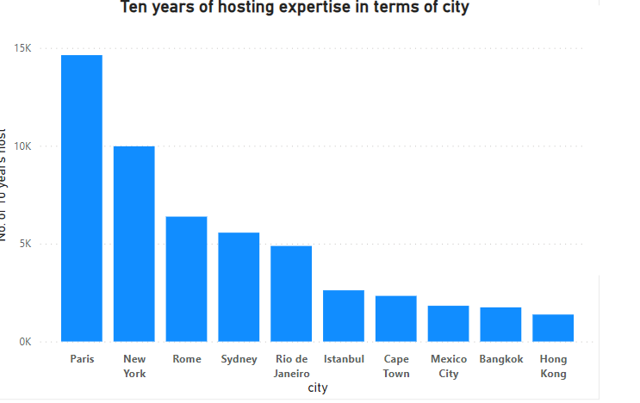
Listing Age and Host Tenure

Slide 9
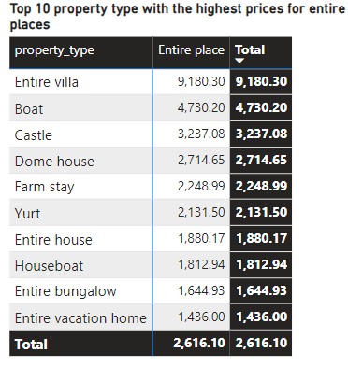
Property Type Price Analysis

Slide 10
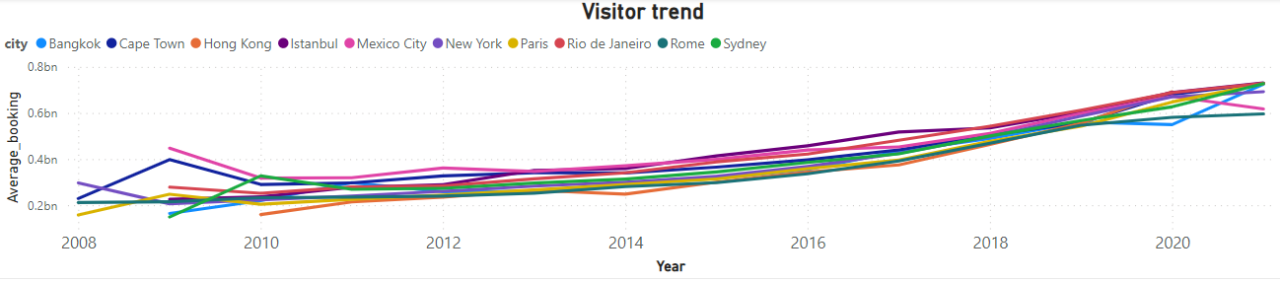
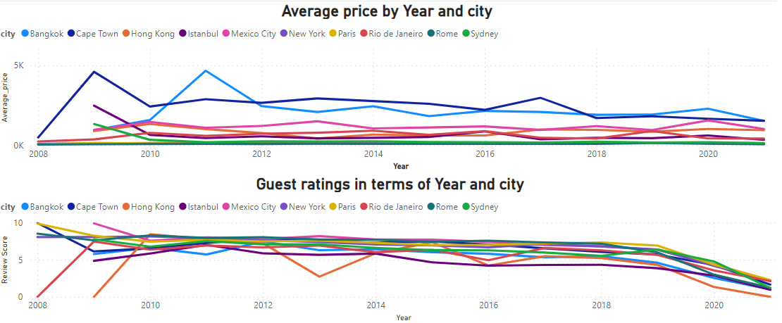
Trend & Insights Report

Slide 11
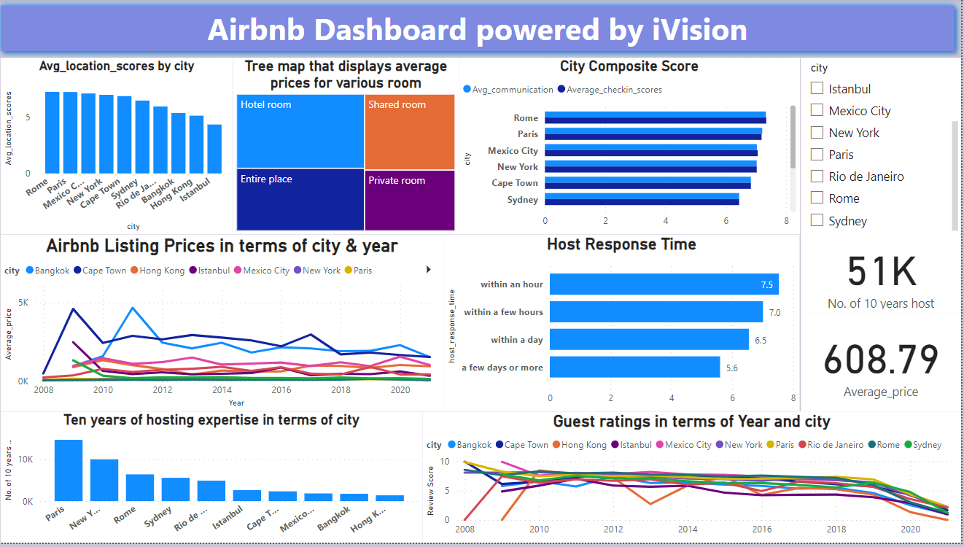
Airbnb Dashboard powered by iVision

Slide 12
Prepared & Presented by
Siddhartha Majumder
ABADS B11
Contact - 7003902099
Email - siddharthamajumder007@gmail.com

